Slide 1

TRANSCEND - caCIS
Integration Solution
June 2011

Slide 2
Contents
TRANSCEND-caCIS Integration
  Storyboards
  Integration Event Flow
  Integration Solution
  Integration Architecture
    Overview of Architectural Components
TRANSCEND-caCIS Integration – Interface Requirements
Mirth Connect – Usage and Issues

Slide 3
TRANSCEND – caCIS Integration – Storyboards
1. Transmit Data to a Study Site
The CRA working on TRANSCEND’s Tolven system enters data for one of the four clinical notes for the subject. Upon completion, the CRA determines that these notes need to be transmitted to the EPIC EMR system located at UPenn.
The user initiates a transfer request for the note using TRANSCEND Tolven’s user interface by selecting the recipient (EPIC system at UPenn in this case), preferred mode of transfer (secure email, secure ftp, XDS NAV) as well as document format (HL7v2, RIM XML ITS, CDA R2) for the recipient.
This routing information, along with the actual clinical note (in the TRIM format), is transferred to the TRANSCEND-caCIS Semantic Adapter. The Semantic Adapter then converts the data to Canonical format and sends it to the caCIS Integration Platform.
The Integration Platform creates a document in the desired format and proceeds to send the document based on selected transfer mode (FTP). The Integration Platform also stores the data in Clinical Data Warehouse. The recipient system receives the data.

Slide 4
TRANSCEND – caCIS Integration - Storyboards
2. Transmit Data to a Physician
A physician on iSPY2 wants to send a patient for consultation to another physician. The iSPY2 physician selects appropriate clinical note for the patient and clicks a button on TRANSCEND Tolven user interface for sending the data.
TRANSCEND Tolven user interface presents a list of possible recipients, transfer modes (secure email, secure ftp, XDS NAV) and document formats (HL7v2, RIM XML ITS, CDA R2).
The user selects the name of the physician to send the Referral Consult Note to, the desired document format and Secure Email as the transfer mode. TRANSCEND Tolven extracts related data and sends it to TRANSCEND-caCIS Semantic Adapter in the native TRIM format.
The Semantic Adapter converts the note into caCIS canonical format and sends it to the caCIS Integration Platform. The Integration Platform creates the document in the desired format, looks up the email address for the intended recipient physician and sends the document in an encrypted manner via secure email to the recipient.
* Physician to Physician use case as per by Dr. Buetow

Slide 5
TRANSCEND – caCIS Integration – Storyboards
3. Transmit Data for Warehousing and Analysis
Over a span of time on iSPY2 clinical trial, the CRAs enter data for multiple patients in TRANSCEND’s Tolven system. Once the entered data is finalized and approved, the TRANSCEND data custodian decides to make the clinical data available to the caCIS Clinical Data Warehouse.
TRANSCEND Tolven transmits data for the selected patient to the TRANSCEND-caCIS Semantic Adapter. The Semantic Adapter transforms some of this data (Clinical Notes) from native Tolven format (TRIM) into the caCIS canonical format. Rest of the data cannot be transformed to the caCIS canonical format.
Semantic Adapter sends all of the data to the caCIS Integration Platform.
The Integration Platform stores the data in Clinical Data Warehouse and makes it available for research and analysis to authorized users.
  Security on the Clinical Data Warehouse is granular. Users who are not already authorized to view the data will not have access.

Slide 6
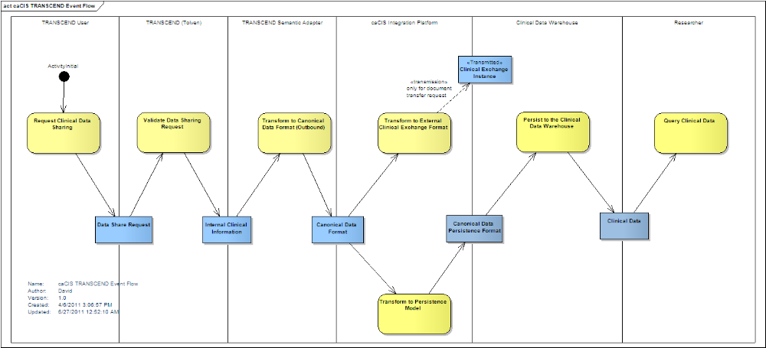
TRANSCEND – caCIS Integration – Event Flow
(Optimally Viewed in the Slide Show mode)

Slide 7
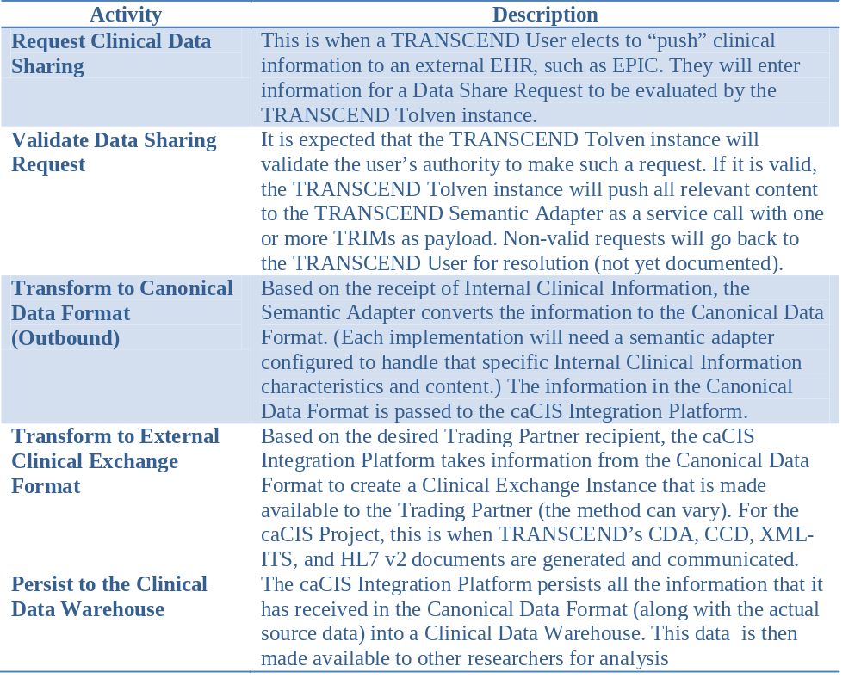
TRANSCEND – caCIS Integration – Event Flow

Slide 8
Proposed Integration Solution
Source System
(Tolven)
Secure Email
/ Secure FTP
Recipient/
Target System
Native
Format
(TRIM)
Integration Platform
Semantic Adapter
Canonical
Model
Processor
Doc Transfer?
Document
Router
NAV
Canonical
Model
Canonical
Model
Document
(Canonical
Model)
Extract
Transform
Load
OpenXDS
XDS
GET
Target
System
Clinical
Data
Clinical Data
Warehouse
Secured
Query
Interface
Clinical
Data

Slide 9
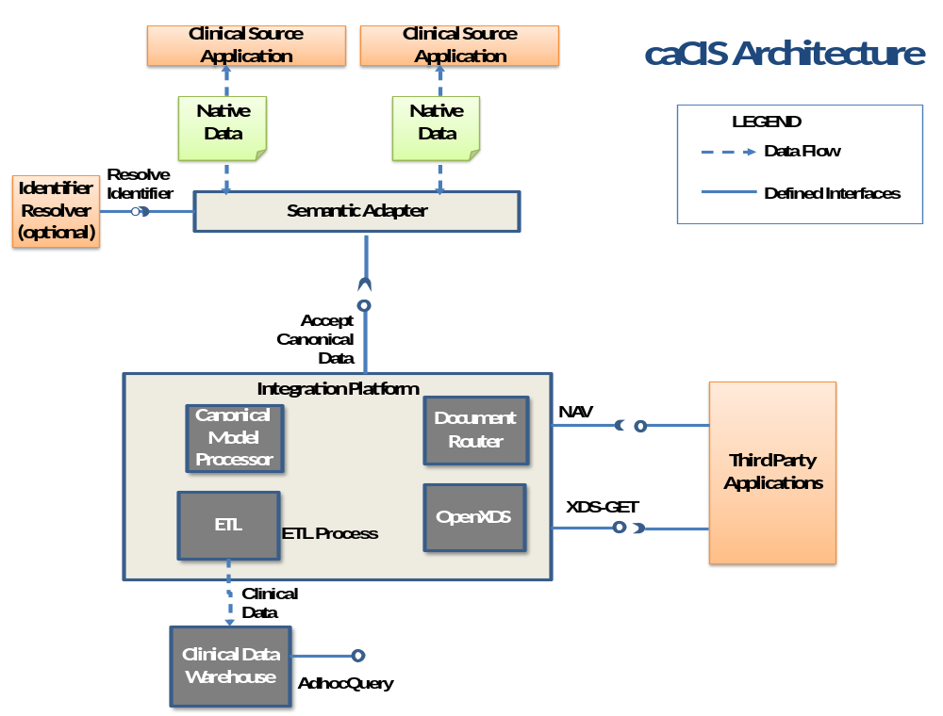

Slide 10
caCIS – Architectural Component - Definitions
No. | Term/Component | Definition
1. | Canonical format | Standards-based target data format that is used as a basis for creation of exchange instances and is also used to populate the Clinical Data Warehouse.
2. | Integration Platform (IP) | The overall caCIS infrastructure component that manages the verification of canonical information, generation and routing of exchange instances and management of transmission of data to the Clinical Data Warehouse. This is the component exposed to external systems involved in data exchange.
3. | Semantic Adapter (SA) | The component that transforms Internal Clinical Data into the Canonical format.
4. | OpenXDS | OpenXDS implements the Cross-Document Sharing (XDS) Registry and Repository. It is used for delivery of data to recipient systems.
5. | Document Router | The caCIS integration platform component responsible for managing the creation of exchange instances and delivering them to their intended recipients.
6. | Canonical Model Processor | The caCIS infrastructure component responsible for receiving information from various source systems (via their individual Semantic Adapter), validating the input data, transforming it into the warehouse persistence format and passing it to the clinical data warehouse.
7. | Clinical Data Warehouse | The repository where the Integration Platform persists clinical data for ad hoc querying.

Slide 11
caCIS – Architectural Component - Implementation Details
No. | Term/Component | Implementation Details
1. | Canonical format | Based on CCD and other broadly used CDA R2 templates
2. | Integration Platform (IP) | Mirth Connect (ESB)
3. | Semantic Adapter (SA) | As the semantic adapter acts like an ESB (enterprise service bus), implementers are not bound to NCI’s choice of the semantic adapter, they can choose a custom integration platform that is acceptable to their enterprise. The caCIS integration platform is loosely coupled with the semantic adapter and this provides the flexibility to “swap” the engine.
4. | OpenXDS | OpenExchange provided by MOSS (Misys Open Source Solutions).
5. | Document Router | Deployed as component of the Integration Platform (on Mirth Connect)
6. | Canonical Model Processor | Deployed as component of the Integration Platform (on Mirth Connect)
7. | Clinical Data Warehouse | Technology/database selection in progress. Evaluating XML databases such as eXist-db and RDF/Triple stores such as Virtuoso.

Slide 12
TRANSCEND Tolven to Semantic Adapter
Interface Requirements

Slide 13
TRANSCEND to Semantic Adapter Interface Requirements
Transfer of Clinical Notes to another site
Tolven will invoke the Semantic Adapter for each Clinical Note Transfer and pass the following information as part of each request:
  Routing Instructions
    List of Recipients (Email addresses or ftp sites)
    List of corresponding Exchange document formats [HL7v2, CCD, RIM-ITS]
    Transfer mechanism [S-MIME/SMTP , FTP, NAV(SMTP)]
  Source Data Payload
    Clinical Note TRIM – One of the following four notes
    Baseline Evaluation Note, Surgical Note, Study Visit, Clinical Staging
  Metadata
    Study Identifier
    Site Identifier
    Subject Identifier
    Initiating User Name (individual user transmitting the information)
    Note: For mapping and design activities, following is needed:
    Complete TRIM structure with all possible tags, sample data and all custom value sets.

Slide 14
TRANSCEND to Semantic Adapter Interface Requirements
Transfer of rest of TRANSCEND data to Clinical Data Warehouse
Tolven will invoke the Semantic Adapter every time it needs to share data and pass the following information as part of each request:
  Source Data Payload
    Will there be one consolidated TRIM?
    Will there be a separate TRIM for PCO data?
    Will the data push from TRANSCEND be periodically scheduled?
  Metadata
    Study Identifier
    Site Identifier
    Subject Identifier
    Note: For mapping and design activities, following is needed:
    Complete TRIM structure with all possible tags, sample data and all custom value sets.

Slide 15
Use of Mirth Connect for Semantic Adapter/Document Router
Mirth Connect is an open source standards based healthcare interface engine and facilitates routing, filtering and transformation of messages between health information systems.
Issue: Mirth Connect (Open Source/Free version) doesn’t support HTTPS
Solution Alternatives:
  Purchase Silver Support for Mirth Connect – Annual Cost = $4,999 (includes SSL plug-in required for HTTPS)
  Use another App. Server (such as Tomcat) to interface with MirthConnect
  Implement secure Apache CXF interface embedded with Mirth Connect
    Implemented for iHub on Mirth Connect v1.8, needs to be tested
    Needs customization of Mirth Connect
  Use another ESB such as Camel in place of Mirth Connect

